Slide 1
Reflection from a conductor (Normal incidence)
The refractive index of a conduction medium is given as
where
The ratio E_{r}/E_{i} is therefore complex and the value of reflected intensity I_{r} is found from

Slide 2
Reflection coefficient E_{r}/E_{i}
The reflection coefficient is given as
The intensity can be found from

Slide 3
REVIEW Reflection and transmission coefficients : oblique incidence
For H perpendicular to the plane of incidence
For E perpendicular to the plane of incidence

Slide 4
Example metal reflected intensity at IR
For copper σ = 6 x 10⁷ (ohm m⁻¹), determine the metal reflected intensity at the IR range.
Using IR frequency ≈ 10¹³ Hz
https://learn.sparkfun.com/tutorials/light/infrared-light
Notes:
≈98%

Slide 5
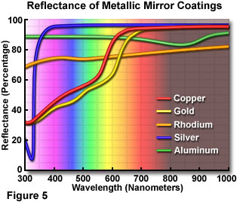
https://www.olympus-lifescience.com/es/microscope-resource/primer/lightandcolor/mirrorsintro/

